Slide 1

Data Exploration
Jennifer Gagner, Mihin Sumaria, Shivam Singh, Yang Fu, Pushkar Kale
Notes:
Pushkar

Slide 2
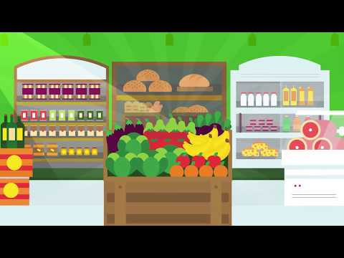
Overview
Instacart delivers groceries from local stores in 2 hours
Instacart released 3 million data points in 2017 for users to analyze the products users order
Notes:
Pushkar

Slide 3
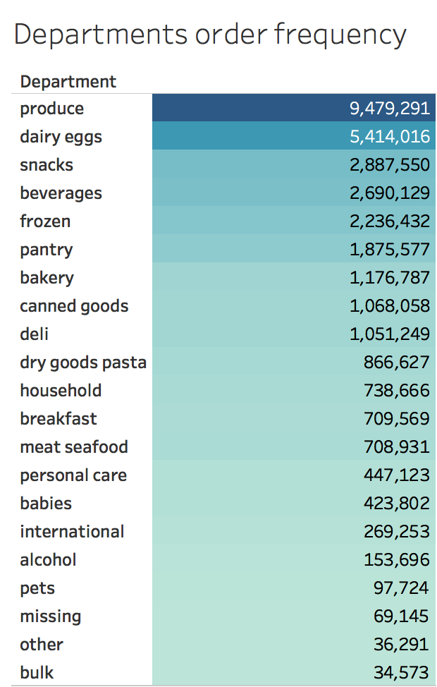
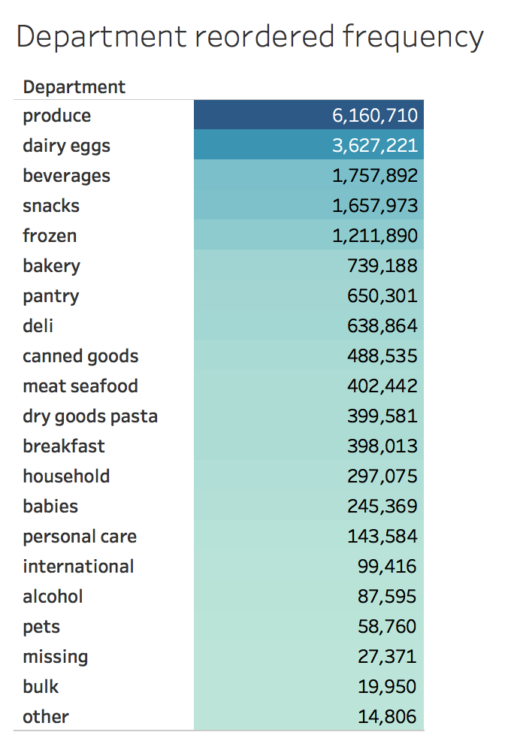
Data Exploration
Notes:
Shivam

Slide 4
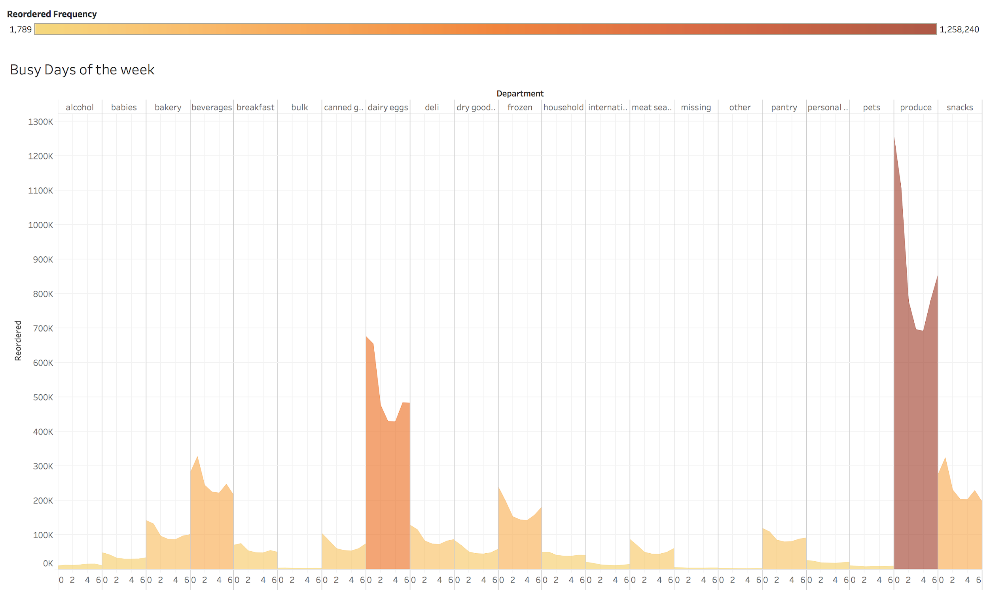
Data Exploration
Notes:
Shivam

Slide 5
Problem - Market Basket Analysis
Association rule mining based on market basket analyses
Create the best, personalized offers for consumers by organizing website
Place co-occurring items in the their own category or build broader categories to accommodate them.
Personalized recommendations based on co-occurrences can be provided to users when they add one of the items to their carts.
Send out personalized emails based on past orders, recommending products.
Notes:
Mihin

Slide 6
Solution: Simple A-to-B Association Rule Mining
Based on the apriori algorithm, find frequent itemsets
Three key metrics for itemsets:
Support: % of reorders that contains the itemA&itemB pair.
Confidence: % of times that B is purchased, given that A was purchased.
Lift: the relationship between A and B. Lift{AB} = support{AB}/(support{A}*support{B}).
= 1, occur together only by chance.
> 1, positive relationship.
< 1, negative relationship.
Notes:
Mihin

Slide 7
Results - Order history data mining
~ 3.2 million orders containing ~ 30 million items
~ 30 million item pairs
48,751 item pairs with support >= 0.01% (min. support threshold)
208 item pairs have positive relationships (lift > 1)
Notes:
Yang

Slide 8
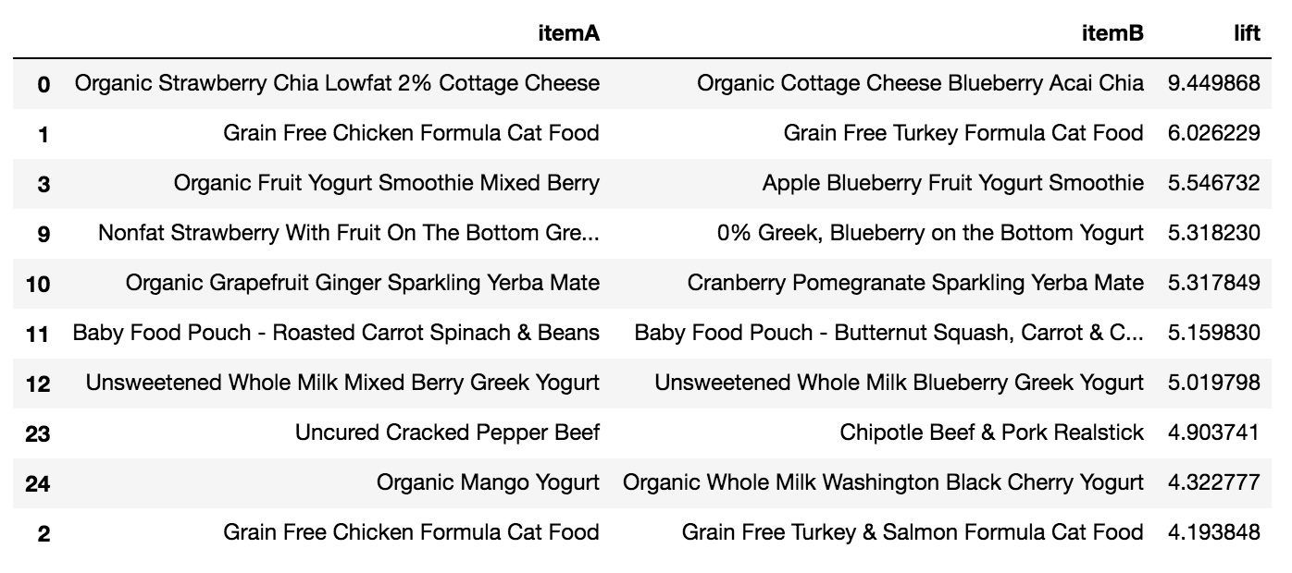
Results - Top 10 Item Pairs
Notes:
Yang

Slide 9
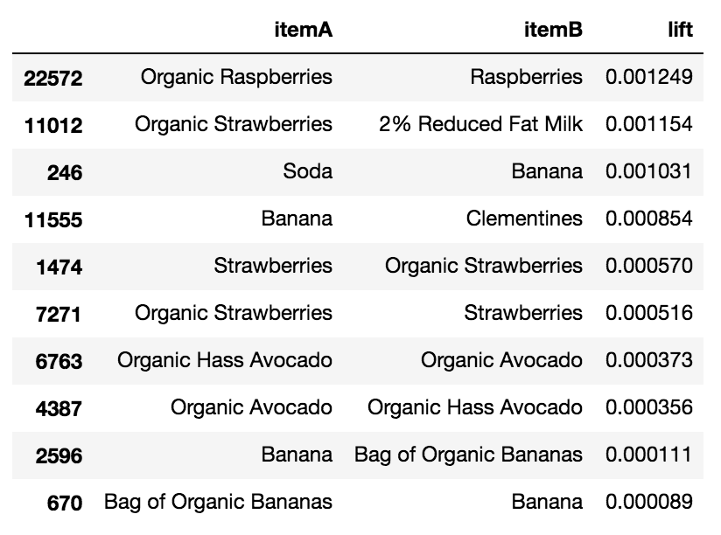
Results - Items Least Likely to be Bought Together
Notes:
Yang

Slide 10
Conclusion
Use association findings for directed product placement and targeted offers
Most associated items are extremely similar
I.e. same item, different flavor
Least associated items are mostly between organic and nonorganic
Can be further expanded to item sets greater than 2
Notes:
Jenn

Slide 11
Thank You!
Notes:
Jenn

